Slide 1
Computer Vision
Fall 2017
Problem Set #3
Zhi Zhang
zhizhang@gatech.edu
Computer Vision @ GT

Slide 2
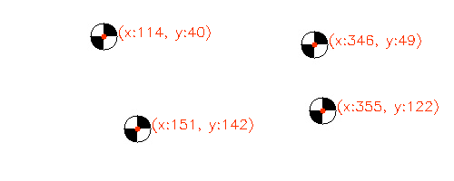
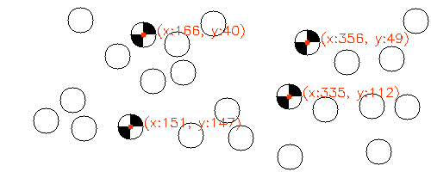
1: Marker detection
ps3-1-a-1.png
ps3-1-a-2.png
Computer Vision @ GT

Slide 3
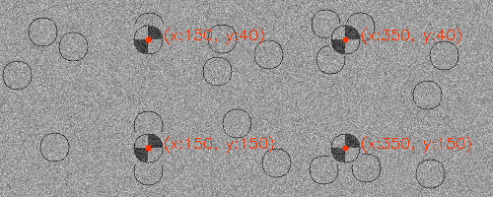
1: Marker detection (cont.)
ps3-1-a-3.png
Computer Vision @ GT

Slide 4
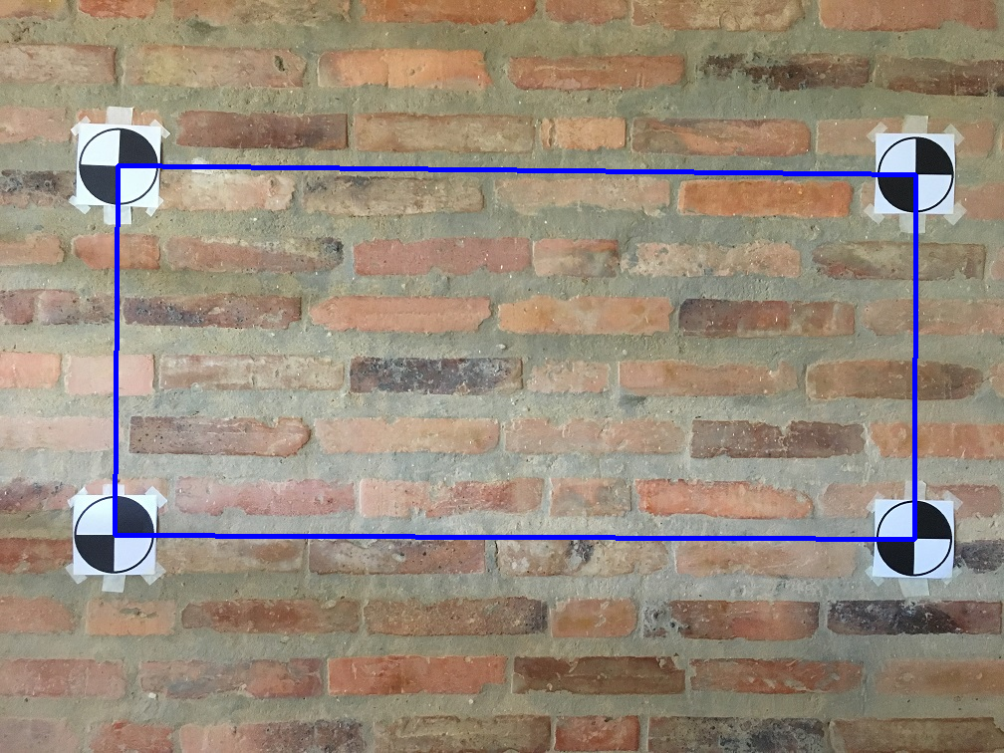
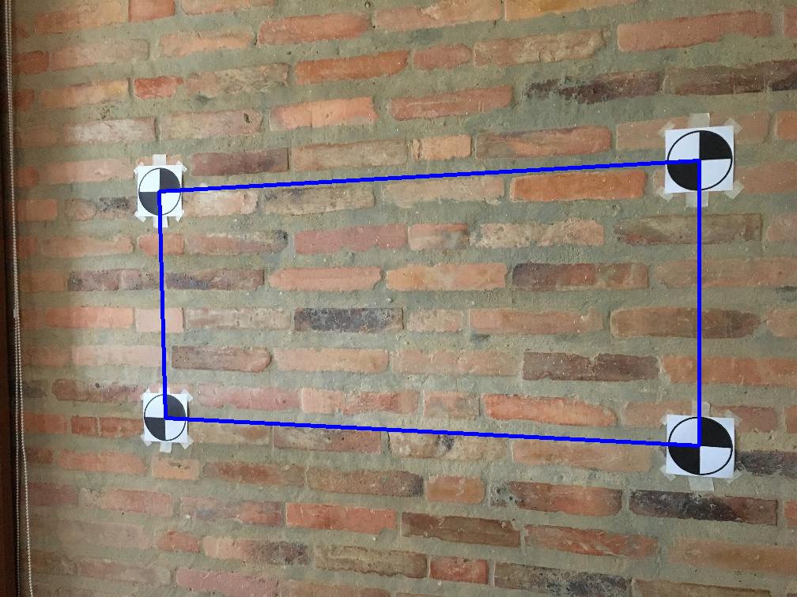
2: Marker detection (wall scene)
ps3-2-a-1.png
ps3-2-a-2.png
Computer Vision @ GT

Slide 5
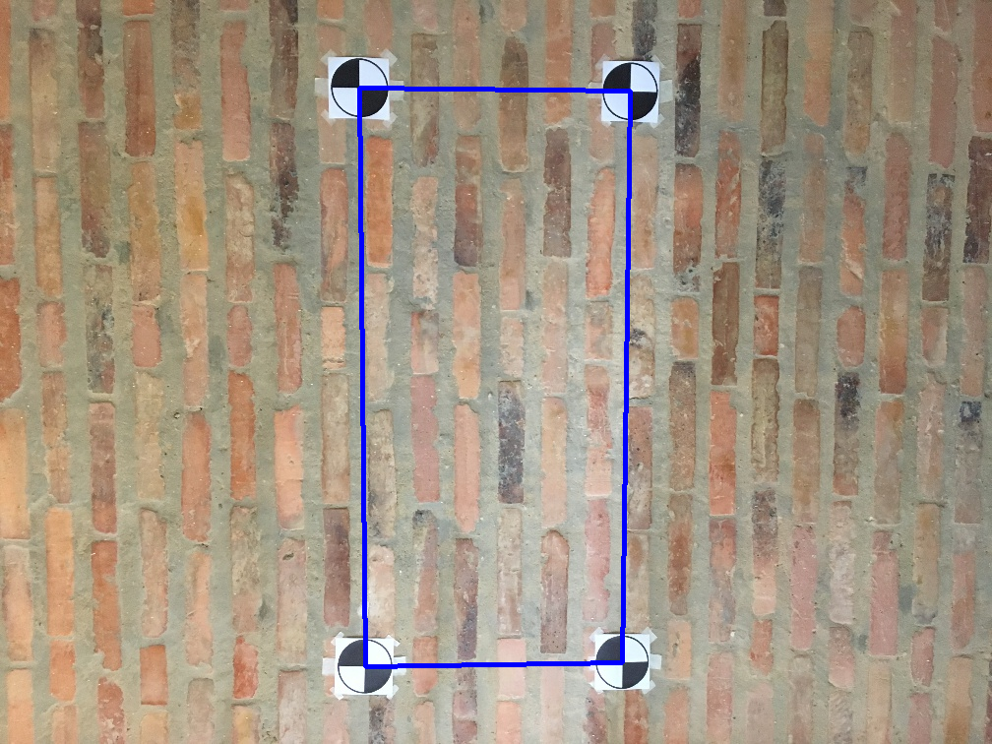
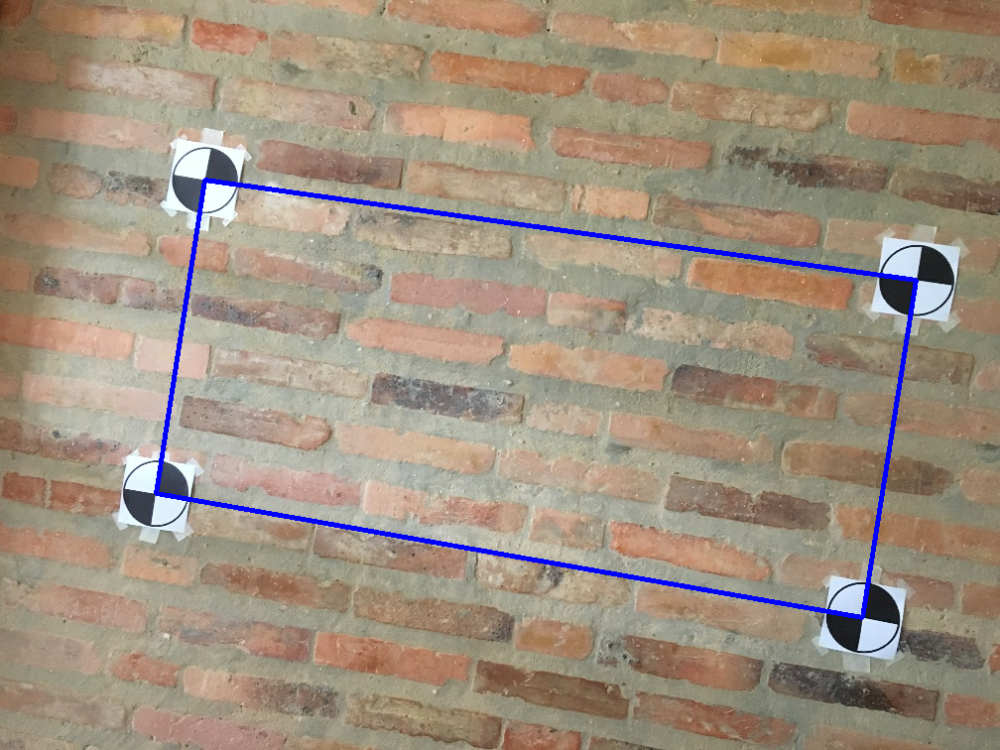
2: Marker detection (wall scene)
ps3-2-a-3.png
ps3-2-a-4.png
Computer Vision @ GT

Slide 6
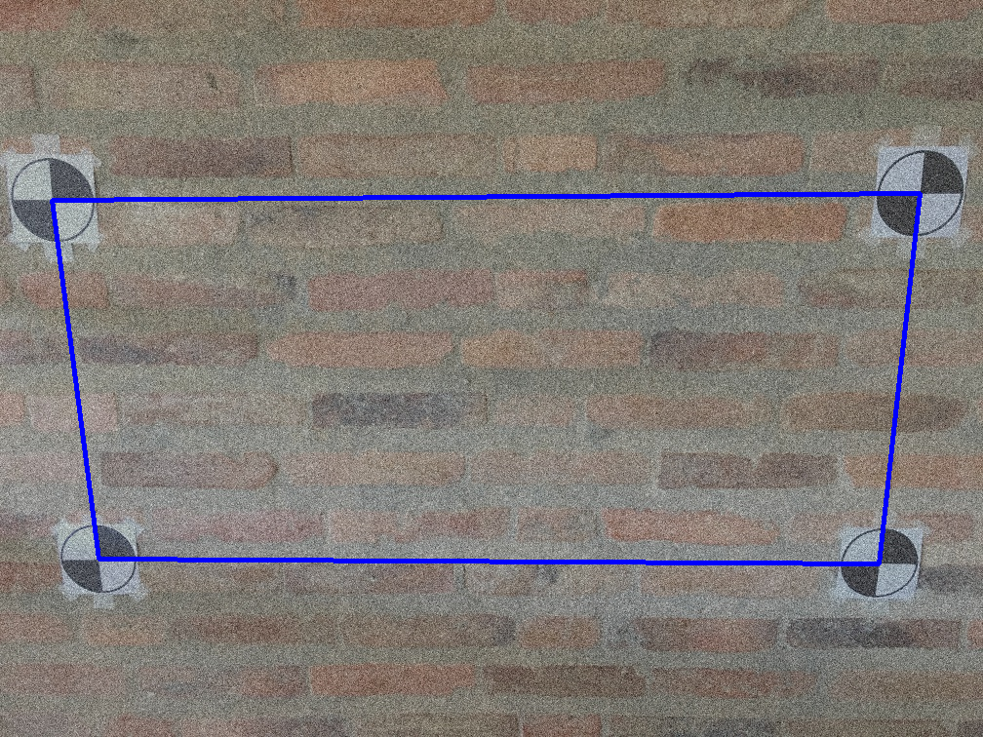
2: Marker detection (wall scene)
ps3-2-a-5.png
Computer Vision @ GT

Slide 7
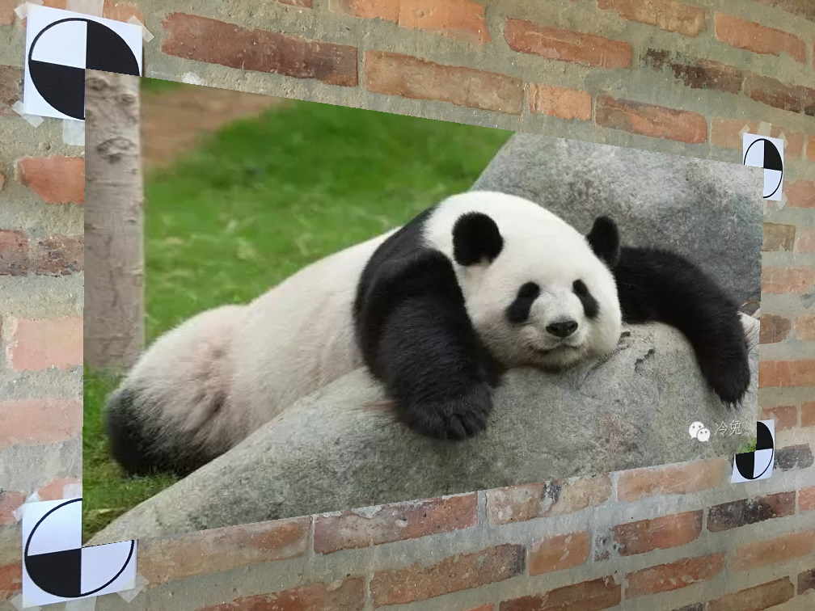
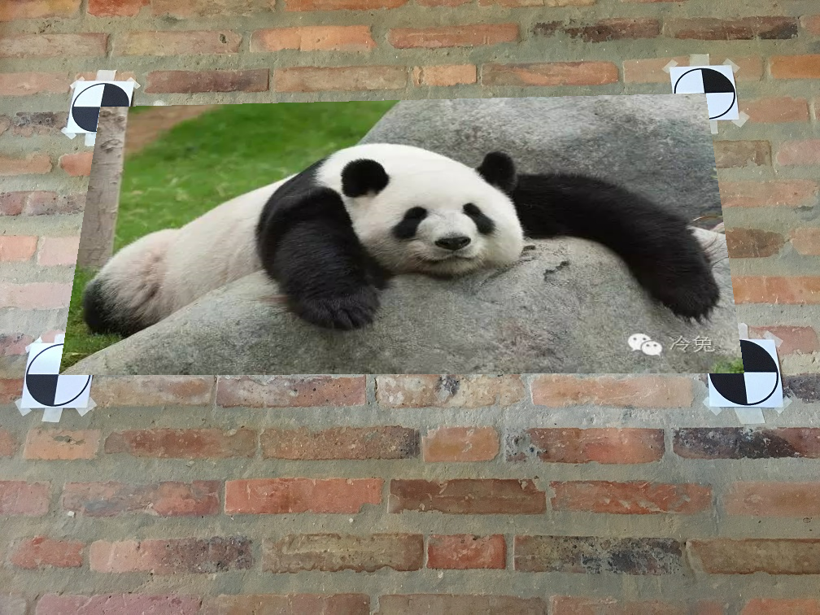
3: Projective Geometry
ps3-3-a-1.png
ps3-3-a-2.png
Computer Vision @ GT

Slide 8
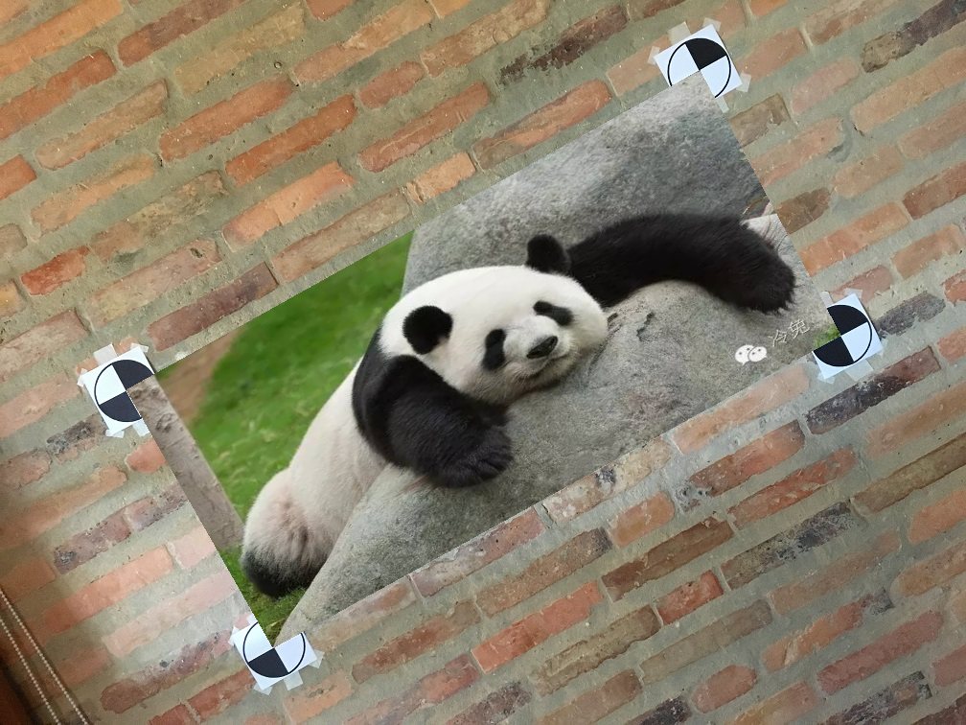
3: Projective Geometry (cont.)
ps3-3-a-3.png
Computer Vision @ GT

Slide 9
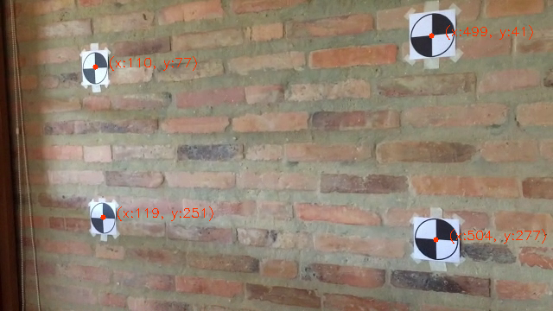
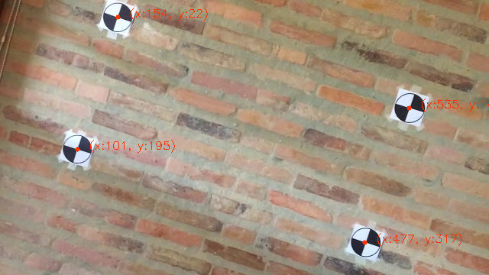
4: Markers in Video
ps3-4-a-1.png
ps3-4-a-2.png
Computer Vision @ GT

Slide 10
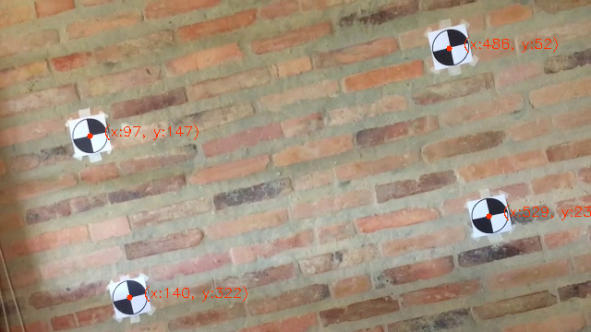
4: Markers in Video (cont.)
Youtube / Dropbox / etc. link:
https://youtu.be/oC-UJldYIXY
ps3-4-a-3.png
Computer Vision @ GT

Slide 11
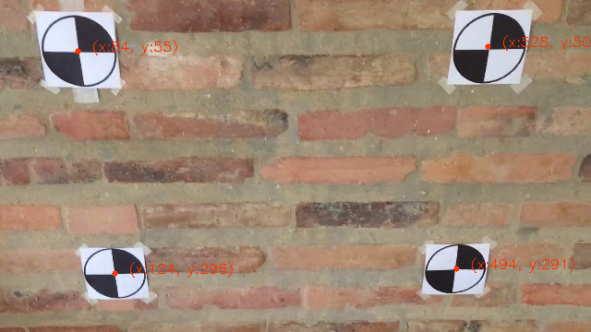
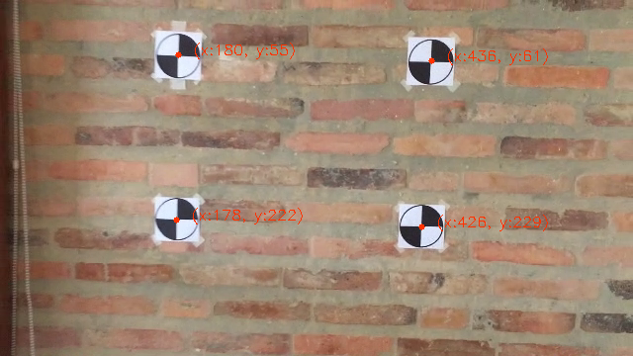
4: Markers in Video (cont.)
ps3-4-a-4.png
ps3-4-a-5.png
Computer Vision @ GT

Slide 12
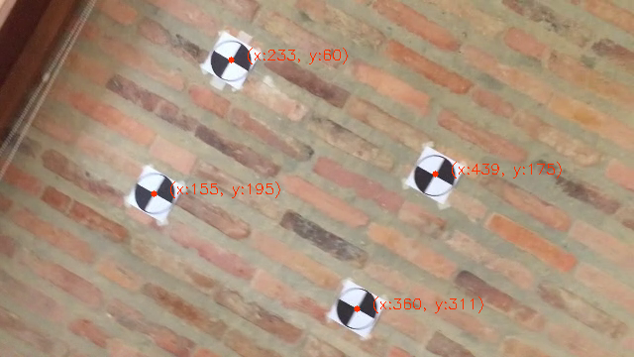
4: Markers in Video (cont.)
Youtube / Dropbox / etc. link:
https://youtu.be/82VaNn5X-H8
ps3-4-a-6.png
Computer Vision @ GT

Slide 13
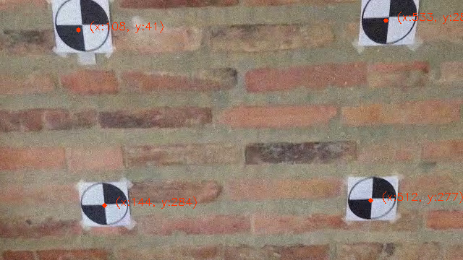
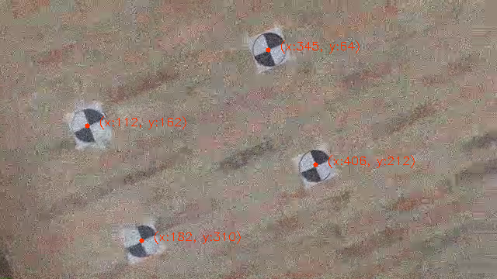
4: Markers in Video
ps3-4-b-1.png
ps3-4-b-2.png
Computer Vision @ GT

Slide 14
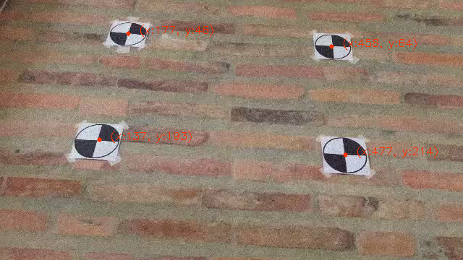
4: Markers in Video (cont.)
Youtube / Dropbox / etc. link:
https://youtu.be/kX8bxaAh--U
ps3-4-b-3.png
Computer Vision @ GT

Slide 15
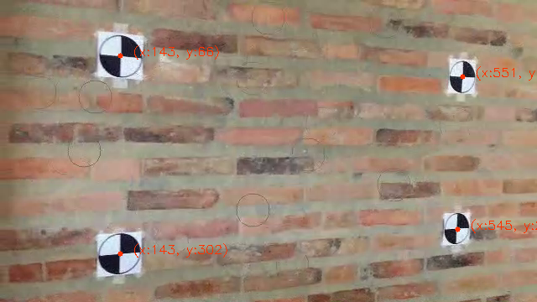
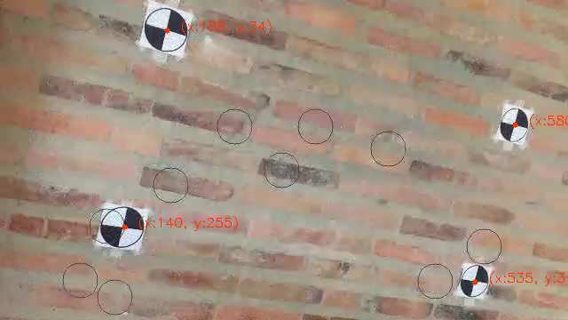
4: Markers in Video (cont.)
ps3-4-b-4.png
ps3-4-b-5.png
Computer Vision @ GT

Slide 16
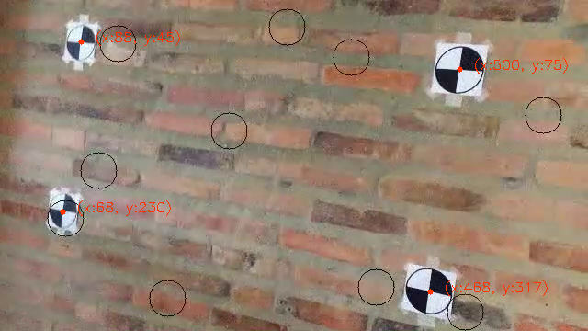
4: Markers in Video (cont.)
Youtube / Dropbox / etc. link:
https://youtu.be/BIRFvWpxjqc
ps3-4-b-6.png
Computer Vision @ GT

Slide 17
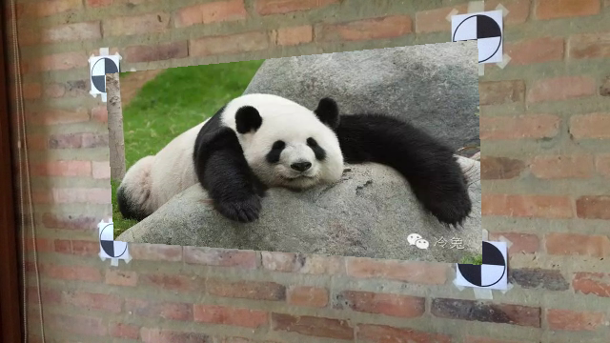
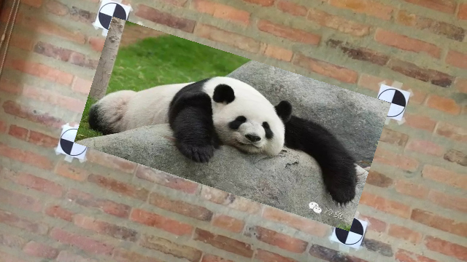
5: AR in Video
ps3-5-a-1.png
ps3-5-a-2.png
Computer Vision @ GT

Slide 18
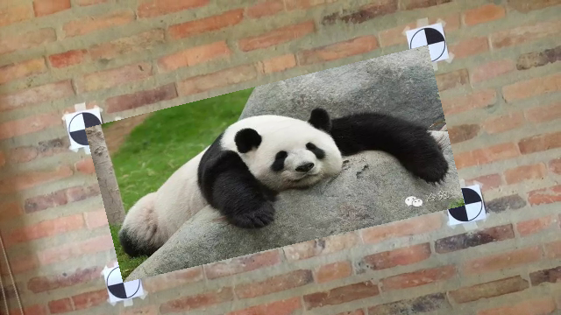
5: AR in Video (cont.)
Youtube / Dropbox / etc. link:
https://youtu.be/YXQoePfvIkM
ps3-5-a-3.png
Computer Vision @ GT

Slide 19
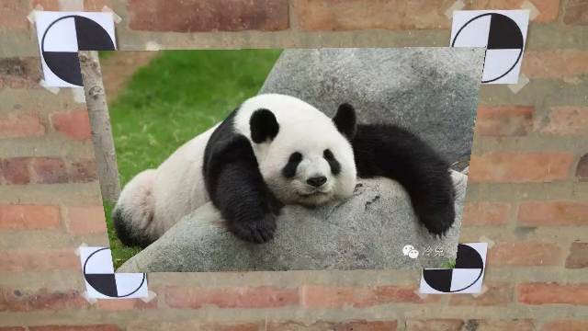
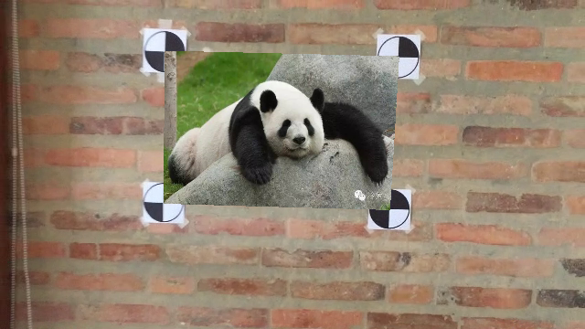
5: AR in Video (cont.)
ps3-5-a-4.png
ps3-5-a-5.png
Computer Vision @ GT

Slide 20
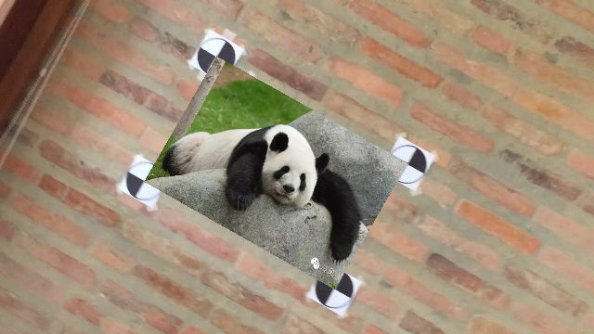
5: AR in Video (cont.)
Youtube / Dropbox / etc. link:
https://youtu.be/jVKxf65MP5c
ps3-5-a-6.png
Computer Vision @ GT

Slide 21
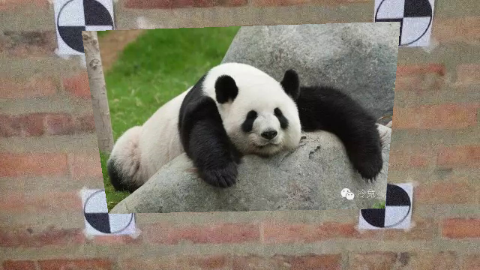
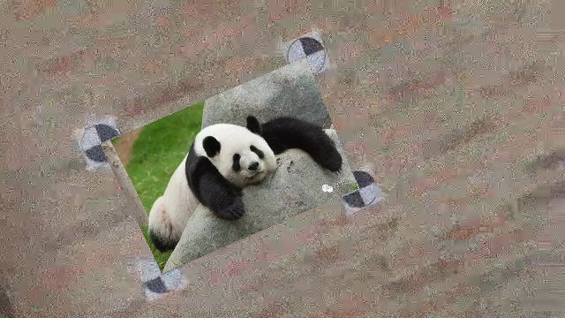
5: Markers in Video
ps3-5-b-1.png
ps3-5-b-2.png
Computer Vision @ GT

Slide 22
5: Markers in Video (cont.)
Youtube / Dropbox / etc. link:
https://youtu.be/Pd9n9vTuC20
ps3-5-b-3.png
Computer Vision @ GT

Slide 23
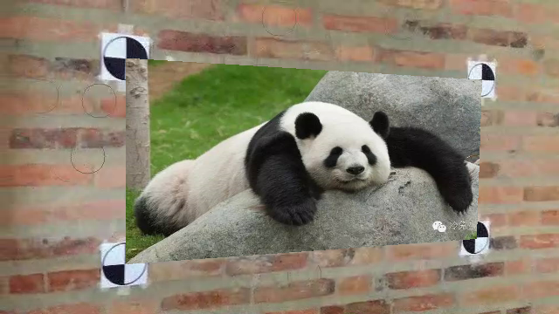
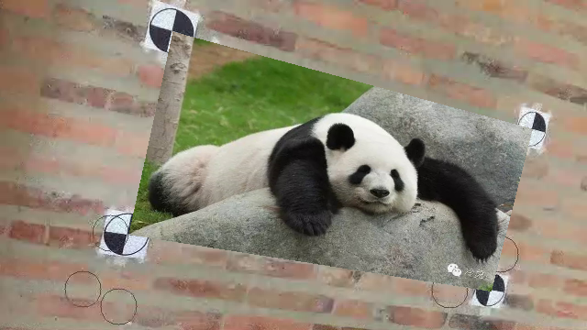
5: Markers in Video (cont.)
ps3-5-b-4.png
ps3-5-b-5.png
Computer Vision @ GT

Slide 24
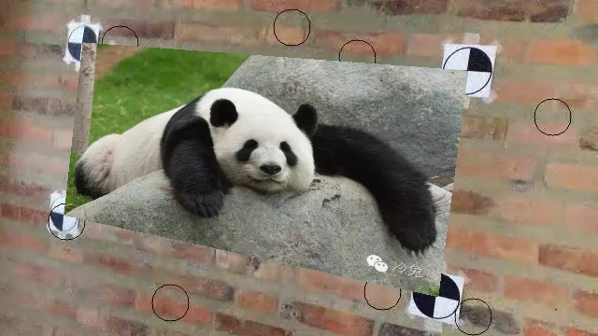
5: Markers in Video (cont.)
Youtube / Dropbox / etc. link:
https://youtu.be/n3y0LgFugk0
ps3-5-b-6.png
Computer Vision @ GT

Slide 25
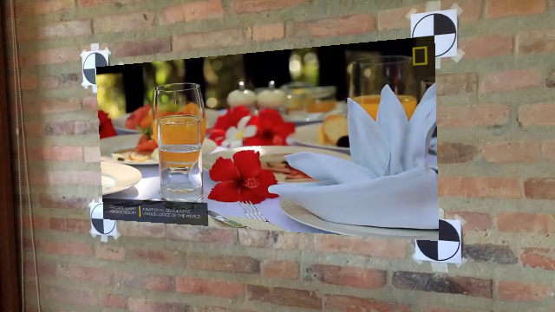
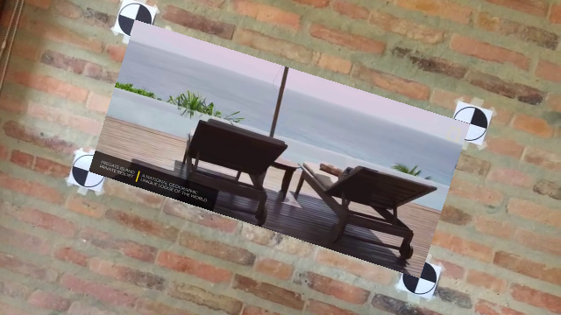
6: Video in Video
ps3-6-a-1.png
ps3-6-a-2.png
Computer Vision @ GT

Slide 26
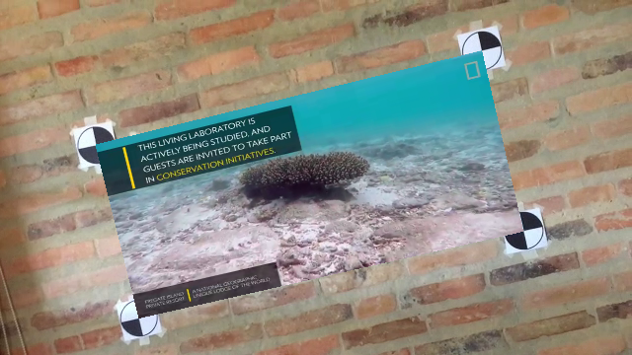
6: Video in Video (cont.)
Youtube / Dropbox / etc. link:
https://youtu.be/ZdG2gVkpMns
ps3-6-a-3.png
Computer Vision @ GT

Slide 27
If your pdf is larger than 7MB
Please compress it using (or something similar):
https://smallpdf.com/compress-pdf
Verify that all images are still visible for grading.

